Slide 1

HCI - Assignment n.2
Design and prototyping of an application using a human-centered approach
Final presentation and demo
Project Title: Personal Finance Management App
Group: Jodionísio Muachifi «97147», João Felisberto «98003» & Diogo Santos «98393»
Lab Class: P4
09-06-2022
HCI 2021-2022

Slide 2
Introduction
Personal Finance Management App
Personal finance is important for everyone and it was never easy to manage.
Financial strategies depend on earnings, living requirements, goals and desires.
The purpose of our app is to help people that have little financial literacy manage their money.
We intend to develop a user-friendly personal finance management app.
HCI 2021-2022
2
Notes:
These first slides are a recap of the first presentation and should be presented without much detail

Slide 3
Project Objectives
Personal Finance Management App
High-level goals
Develop an App that permits users to manage their finances in a simple way.
Allow users to plan their budgets and savings, according to their goals.
Let users strongly control their daily expenses.
Expected outcomes
We aim for a semi-functional application with a minimalist and intuitive interface.
We achieved it as expected! As shown by our user test results.
The benefits
Provide an easy way for users to organize their budgets and savings for their goals.
HCI 2021-2022
3

Slide 4
Personas
Personal Finance Management App
Target Users
People that have little literacy on finance
People with poor money management
HCI 2021-2022
4

Slide 5

Persona 1
Personal Finance Management App
Persona | Scholarship holder
Name, Age, Gender | Ana Bela, 22 y/o, Female
Job | Student at Aveiro University
Background/Environment | She wants to control her daily expenses She wants to save money for her holiday voyage
Needs | She wants an app to help her easily manage her finances
HCI 2021-2022
5

Slide 6
Scenarios
Personal Finance Management App
Ana Bela orders a cup of coffee and wants to register the expense.
Ana Bela's rent goes up, so she needs to readjust the budget
Ana Bela checks how much more money she needs to save for her summer vacation
Ana Bela registers her savings
HCI 2021-2022
6

Slide 7
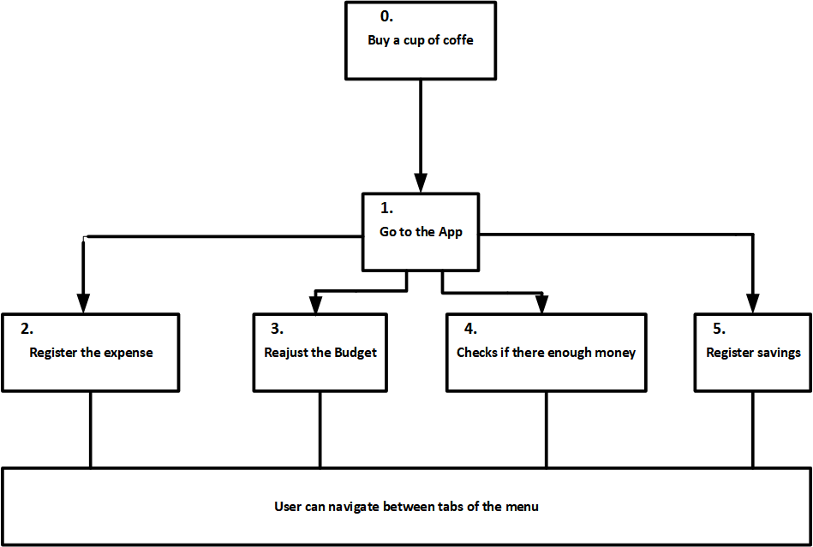
Tasks
Personal Finance Management App
# for scenario 1
HCI 2021-2022
7

Slide 8
Requirements
Personal Finance Management App
Non-functional requirements
Should be easy and practical to use
Mobile
Persistent
Individual
Functional Requirements
Register expenses associated with category
Create, modify and delete budgets
Create, modify and delete saving goals
View expenses, budgets and goals
View how much money of each budget was spent
View how much money was already saved for each goal
Add money to a goal
HCI 2021-2022
8

Slide 9
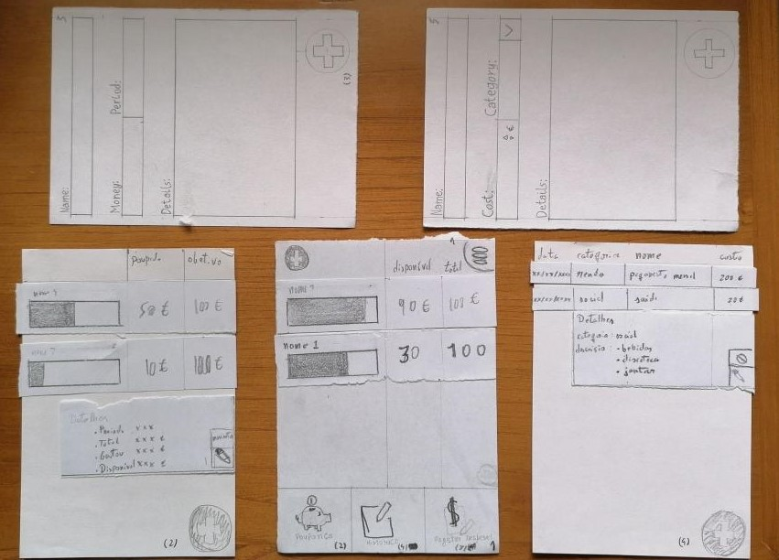
Low Fidelity Prototype (LFP)
Personal Finance Management App
The low fidelity prototype was
developed in paper
We tested it by having potential
users realizing tasks in our app: our classmates
HCI 2021-2022
9
Notes:
This is new material; should be presented in more detail

Slide 10
LFP User Evaluation
Personal Finance Management App
Usability test with paper prototype
Evaluation of the user interface: how intuitive is it and is it easy and quick to execute the given tasks
3 tasks
Users: classmates
Results
The icons were not adequate.
Labels were missing from icons.
END OF 1st DEVELOPMENT CYCLE!
HCI 2021-2022
10

Slide 11


Platform Used for the functional prototype
Personal Finance Management App
The main tool used was Android Studio
Chosen because it made more sense for this app
HCI 2021-2022
11

Slide 12
User Evaluation of the functional prototype
Method used.
Evaluate every aspect of the app, mainly adding expenses and checking budgets
These concern Ana Bela and 1st, 3rd and 4th scenarios
What tasks were used?
6 participants,
1 female 5 males,
20.4 years average (19-24)
2/5 had no experience with such apps, 1/5 had a lot of experience
We used an SUS post task questionnaire and a task difficulty assessment form
HCI 2021-2022
12

Slide 13
User Evaluation of the functional prototype
I think that I would like to use this system frequently. | 3
I found the system unnecessarily complex. | 4
I thought the system was easy to use. | 2.2
I think that I would need the support of a technical person to be able to use this system. | 3.4
I found the various functions in this system were well integrated. | 2.4
I thought there was too much inconsistency in this system. | 4.2
I would imagine that most people would learn to use this system very quickly. | 2.4
I found the system very cumbersome to use. | 3.2
I felt very confident using the system. | 2.6
I needed to learn a lot of things before I could get going with this system. | 3.8
END OF 2nd DEVELOPMENT CYCLE!
HCI 2021-2022
13

Slide 14
User Evaluation of the functional prototype
 | lost | help | difficulty
Register a coffee purchase (0.60 €) | 0.43 | 0.14 | 4.57
Verify whether you can afford a 10€ meal | 0.57 | 0.29 | 3.57
Create a budget for streaming services of 20€ per month | 0.29 | 0.43 | 4.14
Check how much more money you need to save for your summer vacation | 0.43 | 0.29 | 4.29
Add 20€ towards your summer vacation fund | 0.43 | 0.29 | 3.29
END OF 2nd DEVELOPMENT CYCLE!
HCI 2021-2022
14

Slide 15
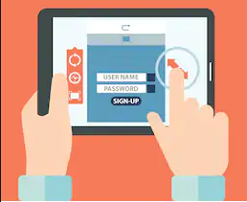
Demo
Insert app title here
Present the main features.
HCI 2021-2022
15

Slide 16
Future work
Make the windows a bit more different
Get better icons and text
Add graphics for better analysis
Effort of each group member
Everyone contributed the same amount.
HCI 2021-2022
16

Slide 17
Acknowledgments
To all participants
Bibliography
Cooper, A., R. Reimann, and D. Cronin, About Face 3 The Essentials of Interaction Design. Wiley Publishing, Inc., 2007
HCI 2021-2022
17

